Slide 1
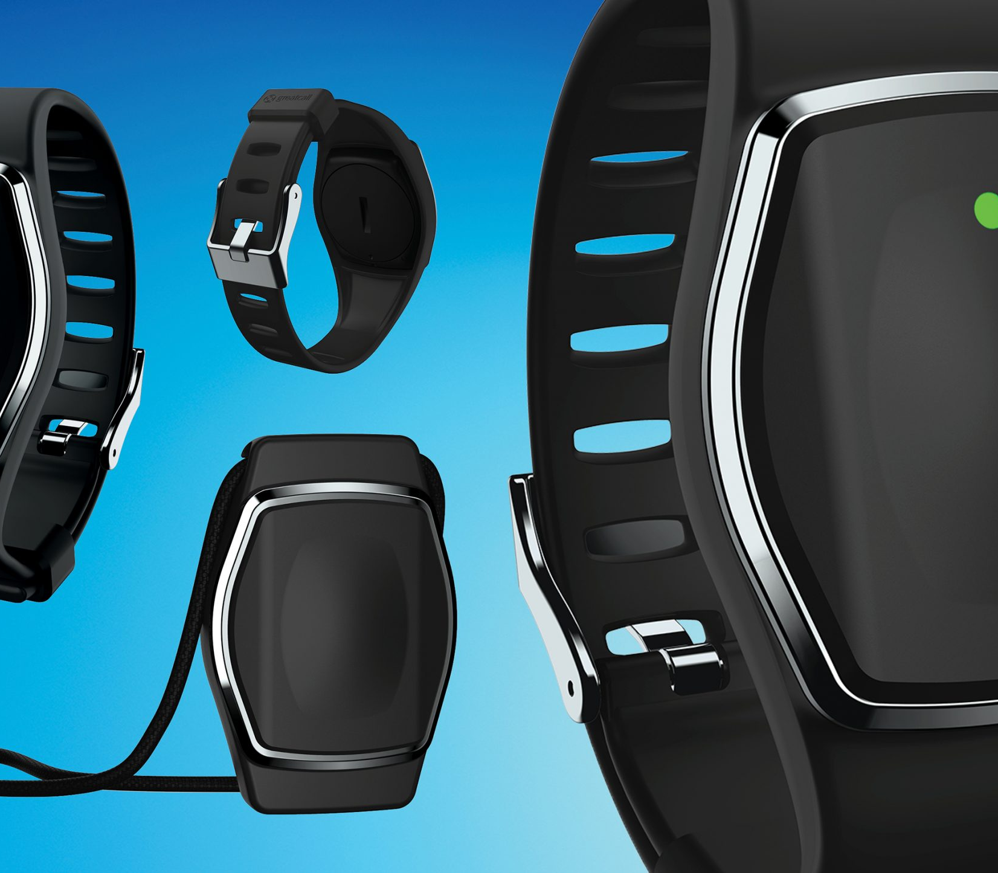
Product Proposal
Linear Optimisation Perspective
Notes:
This template is provided by https://www.free-power-point-templates.com/

Slide 2
Business Proposal Statement & Objectives
Problem Statement
This is a linear optimisation problem with the overall aim of determining the feasibility of developing a new product that offers better services for a bigger market segment and generates higher profit per unit compare to our exiting product.
Objectives
To determine the feasibility of producing any of Type X and Type Y and sell them
To determine whether it is better to produce only Type X or Type Y or both types
To determine the proportional combination of Type X and Type Y that guarantees maximum

Slide 3
Method Selection & Justification
Method
Simplex Linear Programming
Justification
It helps to determine the feasibility of the proposed product in terms of profit
It provides various feasibly profitable proportional combinations of the proposed and existing products and then suggests the one that assures maximum profit.
Most importantly, it will provides various alternatives that can be explored considering market uncertainties or peculiarities that may be difficult to capture mathematically.

Slide 4
Procedure
MODEL
Objective Function: | $25*x + $30*y
Hour_Per_Unit Constraint | (1/200)*x + (1/400)*y <= 40
Weekly Production Constraint (x) | x <= 6000
Weekly Production Constraint (y) | y <= 4000
SOLUTION TOOLS
The solutions were provided using the following tools:
Tools | Justification
Excel (Solver) AMPL (Simplex) Graphical Method Python (Revised Simplex) | What if analysis Easy and fast Feasible solution region Validation of optimal solution

Slide 5
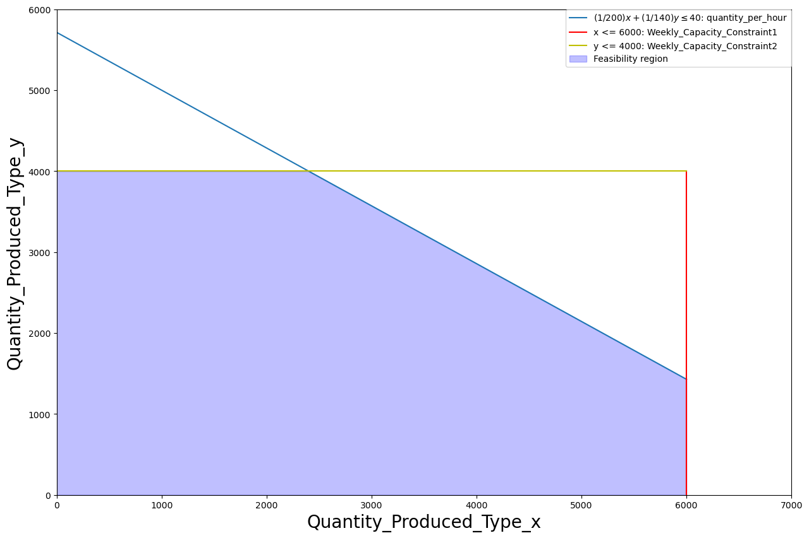
RESULTS VISUALISATION
FEASIBLE SOLUTION REGION
SIMPLEX LINEAR PROGRAMMING SOLUTION

Slide 6
SCENARIO ANALYSIS
 | Type X Only | Type Y Only | Both X & Y
Weekly Production (Units) | 6000 | 4000 | Type X | Type Y
 |  |  | 6000 | 1400
Profit Per Unit | $25 | $30 | $25 | $30
Time (h) | 30 | 29 | 30 | 10
Time Slack | 10 | 11 | 0 | 0
Profit | $150000 | $120000 | $150000 | $42000
 |  |  | $192000
Key Outcomes
It is feasible to produce any of Type X and Type Y with expected profits of $150,000 and $12000 respectively, subject to machinery, person-hour and capacity of specialist available. Both have time slack of 10 and 11 hours respectively.
However, the maximum profit of $192000 is guaranteed when both types are produced in the proportional combination of 6000 and 1400 respectively.

Slide 7
ANTICIPATED CHALLENGES
Challenges | Likely Issues | Solutions
Competition | Competition from incumbent giants Competition from new entrant Composite demand for type y causing decrease in demand for type x Competition from substitute products | Gathering adequate market intelligence e.g. PEST & VUCA analysis Getting customers’ feedback Provide competitive price for the customer Maintaining direct communication channel with the customers Develop a unique value e.g. free health tips, free medical test, free software update, self-servicing, warranty, replacement, etc. and promote through rigorous marketing campaign
FDA Regulation | Meeting the condition for market entrance | Premarket notification to FDA Premarket approval from FDA Market listing Quality System (QS) regulation
Overselling | Overselling could lead to: Queue Delay in delivery | Capacity expansion Digitised inventory management Efficient forecasting models
Underselling | Difficulty with usage Lack of trust in the effectiveness and efficiency of the new product | This is expected for a new product in an existing market. Agile methodology that involves improvement of the product based on the customers’ feedback could be used.
Defeat | User interface defect Quality defect | Total quality management approach based on six sigma Pilot testing

Slide 8
CONCLUSIONS
A weekly production of 6000 type x and 1400 type y guarantees a maximum profit of $192000 based on our current capacity.
However, type y with higher profit per unit and improved services that offer pre-diagnosis monitoring promises a potentially bigger market and could generate higher return if necessary investment can be made on marketing and production capacity expansion.

Slide 9
FOLLOWUP QUESTIONS
How much is the company willing to spend on market penetration campaign?
Does the company have immediate plan to expand its capacity?

Slide 10
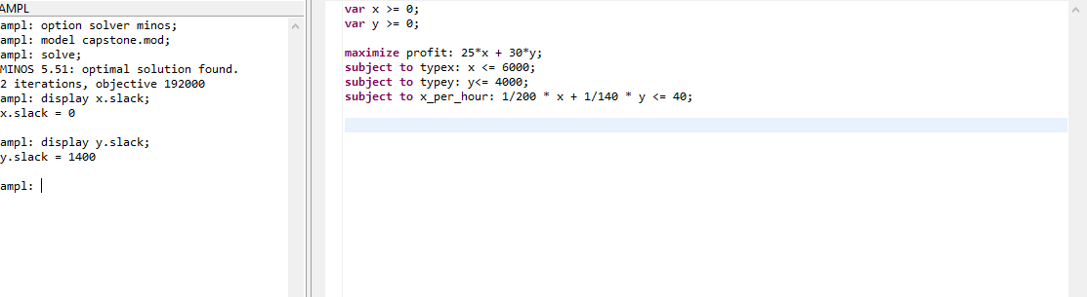
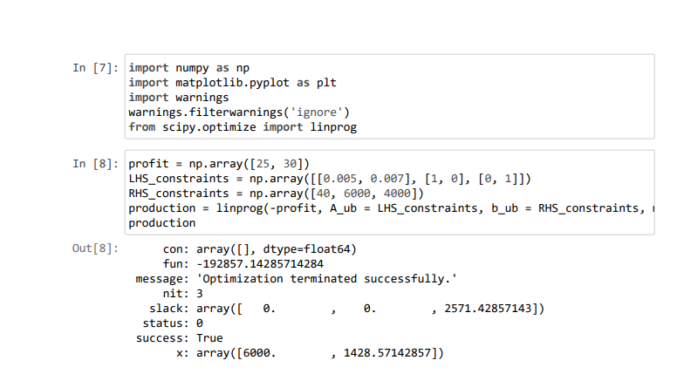
APENDICE

Slide 11

Thank You!
Notes:
This template is provided by https://www.free-power-point-templates.com/

